Slide 1

Workday Adoption: Log ins
T + 30
10 November 2025

Slide 2
Weekly OCM & Training 24th October 2025
01 | Summary dashboard
02 | Workday Adoption summary T + 30 (Unique users)
03 | Workday Knowledge articles by categories
04 | Recommended actions

Slide 3






Workday adoption continues to progress at T + 30 recommend effort to narrow gap of manager log ins
Below summary as of 6th Nov 2025
61%
85%
61%
83%
Of the total # of registered users* logged in successfully
Of all registered managers logged in successfully
Of registered Franchise Park users logged in successfully
Of registered users in HO Amsterdam and loc. Offices logged in
57%
3,947
38%
Of registered users in Owned Parks logged in
Knowledge Articles were read in Workday
Knowledge Articles read related to HR Policies
Update 06/11/2025

Slide 4
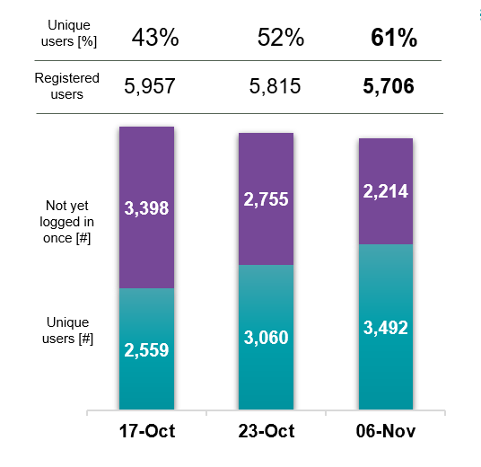
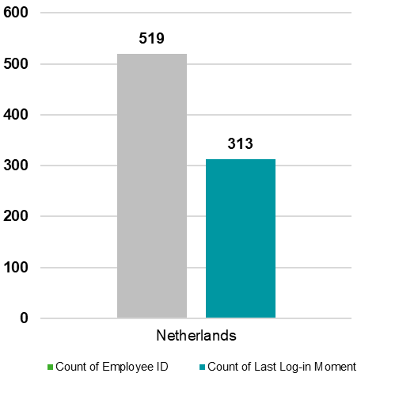
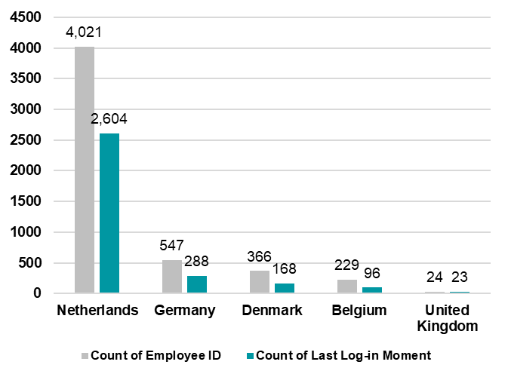
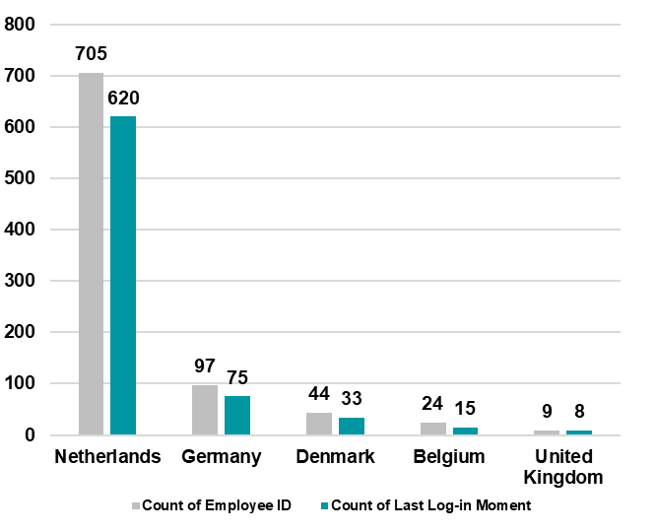
Workday adoption update summary T + 25 (1 of 2)
Summary
Adoption L1(Log in once)
Comments
61% of expected (registered) users logged
Decrease in registered users (terminations)
Next steps
Dep leads to confirm team members who need to log in
Dep leads ensure team members’ log in
Adoption L1 by Franchise Parks
Workday launched 13 October to all business users
61% of reg. users logged in once - of all business users
85% of registered managers logged in
Decline of # registered users due to exits (terminations)
60% of Franchise Park users logged in
61% of Owned Park / HO users logged in at least once
Adoption L1 by Owned Parks / HO
Adoption L1 by Managers
Comments
85% of managers have logged in
Across HO, Owned & Franchise Parks
Next steps
Dep leads to confirm team members who need to log in
Dep leads ensure team members’ log in
Update 06/11/2025

Slide 5
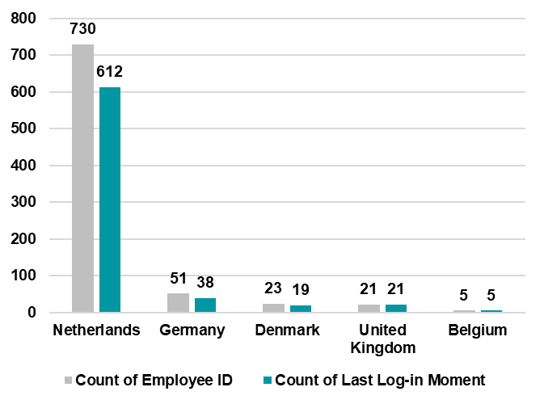
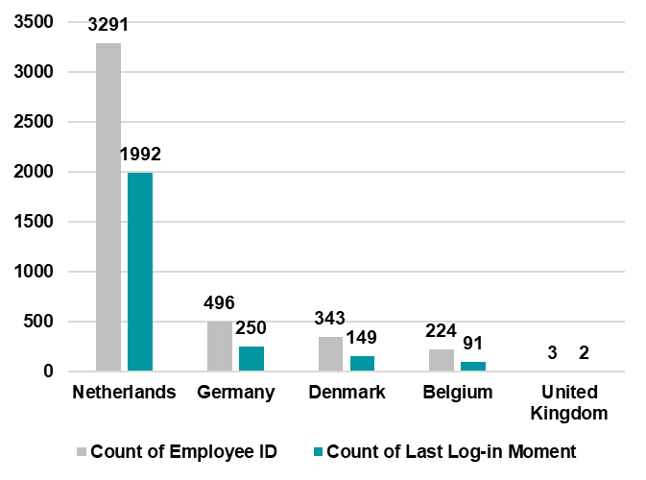
Workday adoption update summary T + 25 (2 of 2)
Summary
Adoption L1* by Owned Parks
HO / Owned Parks (Detail)
83% of all business users in the Head Office Amsterdam (and local offices) logged in once
57% of all business users in Owned Parks logged in once
Recommended actions:
Increase # of unique users via comms and Senior / Area Managers
Adoption L1* by Office
*Adoption L1 : Logged in to Workday at least once
Update 06/11/2025

Slide 6
% of Workday Knowledge Articles read by 6/11
3,947 Knowledge Articles were created and read
Categories applied (proposed)
HR Policies & employment conditions
Rules and guidelines governing employment terms, benefits, and workplace conduct.
Onboarding & offboarding
Processes, manuals, and instructions for joining or leaving the organisation.
Compensation & benefits
Salary scales, allowances, pension, insurance, and perks.
Leave & Absence management
Policies and guides for sick leave, parental leave, and absence procedures.
Recruitment & Workforce management
Hiring processes, job evaluation, and performance management.
Mobility & travel
Car policies, private lease, NS Business Card, travel insurance, and mobility schemes.
Discounts & employee perks
Staff discounts on products, services, and benefits programmes.
Compliance & governance
Whistleblower policy, handling personal data, code of conduct, and official warnings.
Health, Safety & Wellbeing
Smoking policy, trauma support, ergonomics, and occupational health services.

Slide 7
Recommended actions
Increase # of unique users
Review list for users who face issues – Marc / Rene (tbc)
Provide Area Managers in Franchise Parks and Owned Parks with list of users – Marc/Rene
Provide Senior Managers in HO and local offices with list of unique users – Marc/Rene
Based on that list, Area and Senior Managers to ask their teams to (1) review list for users who are not expected to use Workday (near termination of contract, etc) (2) ask their teams to make effort to log in
Note: Some users still face issues to log in, hence, review of list is recommended first

